Slide 1
Enhancing performances
Final presentation
System on Chip design laboratory
Course code 384.178
Lecturer Nahla El-Araby
Winter semester 2020/2021
23 February 2021
Giacomo Giannetti 12006424 e12006424@student.tuwien.ac.at
Benjamin Gräf 51832224
Zifei Li 51813032
Amer Ahmic 1225650

Slide 2
Table of contents
Introduction
Algorithms
Original CORDIC
Para-CORDIC
FPAX-CORDIC
Hardware implementations
Comparisons
Demo
Conclusion

Slide 3
Table of contents
Introduction
Algorithms
Original CORDIC
Para-CORDIC
FPAX-CORDIC
Hardware implementations
Comparisons
Demo
Conclusion

Slide 4
Introduction
Addressed topic: approximate computing
Summary: analysis of three CORDIC algorithms and their comparisons in terms of accuracy, delay, power and area.
The three algorithms, evaluating the trigonometric sine and cosine functions, are:
Basic CORDIC (sequential exact algorithm)
Para-CORDIC (combinatorial exact algorithm)
FPAX-CORDIC (combinatorial approximated algorithm)
Top level simulation of the algorithms using Python
Bit level representation of the algorithms in Matlab
Hardware implementation using VHDL
Testbenches to validate design
Bash and python scripts to evaluate algorithm accuracy
Vivado used for the delay, area and speed comparisons

Slide 5
Table of contents
Introduction
Algorithms
Basic CORDIC
Para-CORDIC
FPAX-CORDIC
Hardware implementations
Comparisons
Demo
Conclusion

Slide 6
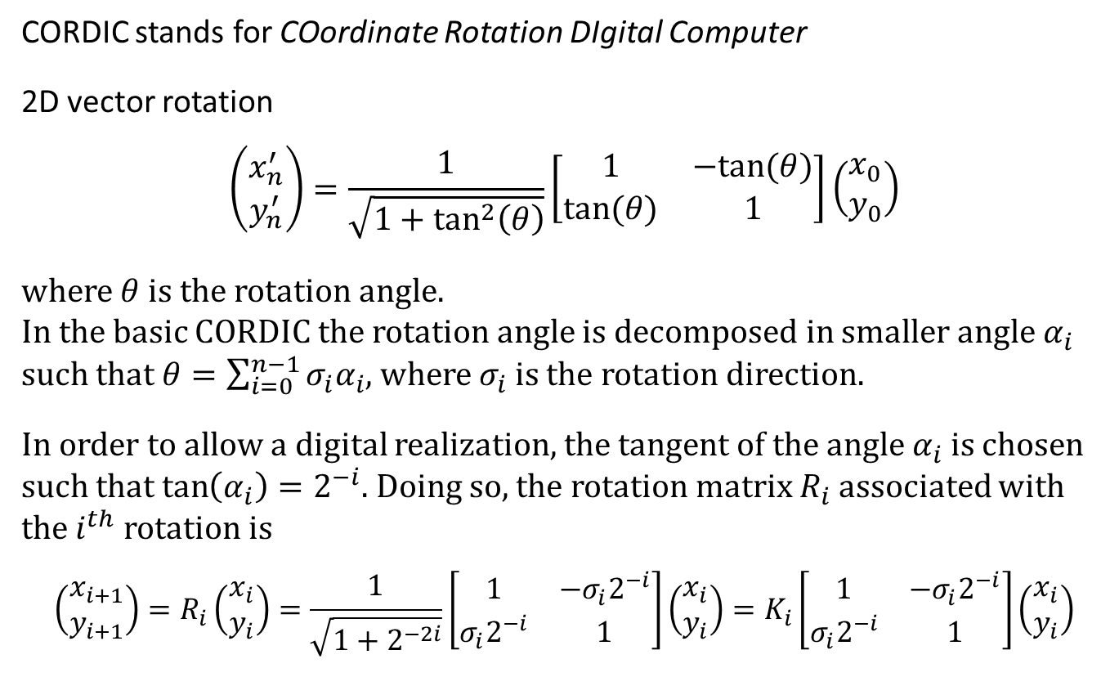
Basic CORDIC
CORDIC stands for COordinate Rotation DIgital Computer
2D vector rotation
$$\left(\begin{matrix}x_{n}^{′} \\ y_{n}^{′}\end{matrix}\right)=\frac{1}{\sqrt{1+\tan^{2}\left(θ\right)}}\left[\begin{matrix}1 & −tan⁡(θ) \\ \tan{(θ)} & 1\end{matrix}\right]\left(\begin{matrix}x_{0} \\ y_{0}\end{matrix}\right)$$
where $θ$ is the rotation angle. In the basic CORDIC the rotation angle is decomposed in smaller angle $α_{i}$ such that $θ=\sum_{i=0}^{n−1}{σ_{i}α_{i}}$, where $σ_{i}$ is the rotation direction.
In order to allow a digital realization, the tangent of the angle $α_{i}$ is chosen such that $\tan\left(α_{i}\right)=2^{−i}$. Doing so, the rotation matrix $R_{i}$ associated with the $i^{th}$ rotation is
$$\left(\begin{matrix}x_{i+1} \\ y_{i+1}\end{matrix}\right)=R_{i}\left(\begin{matrix}x_{i} \\ y_{i}\end{matrix}\right)=\frac{1}{\sqrt{1+2^{−2i}}}\left[\begin{matrix}1 & {−σ}_{i}2^{−i} \\ σ_{i}2^{−i} & 1\end{matrix}\right]\left(\begin{matrix}x_{i} \\ y_{i}\end{matrix}\right)=K_{i}\left[\begin{matrix}1 & {−σ}_{i}2^{−i} \\ σ_{i}2^{−i} & 1\end{matrix}\right]\left(\begin{matrix}x_{i} \\ y_{i}\end{matrix}\right)$$

Slide 7
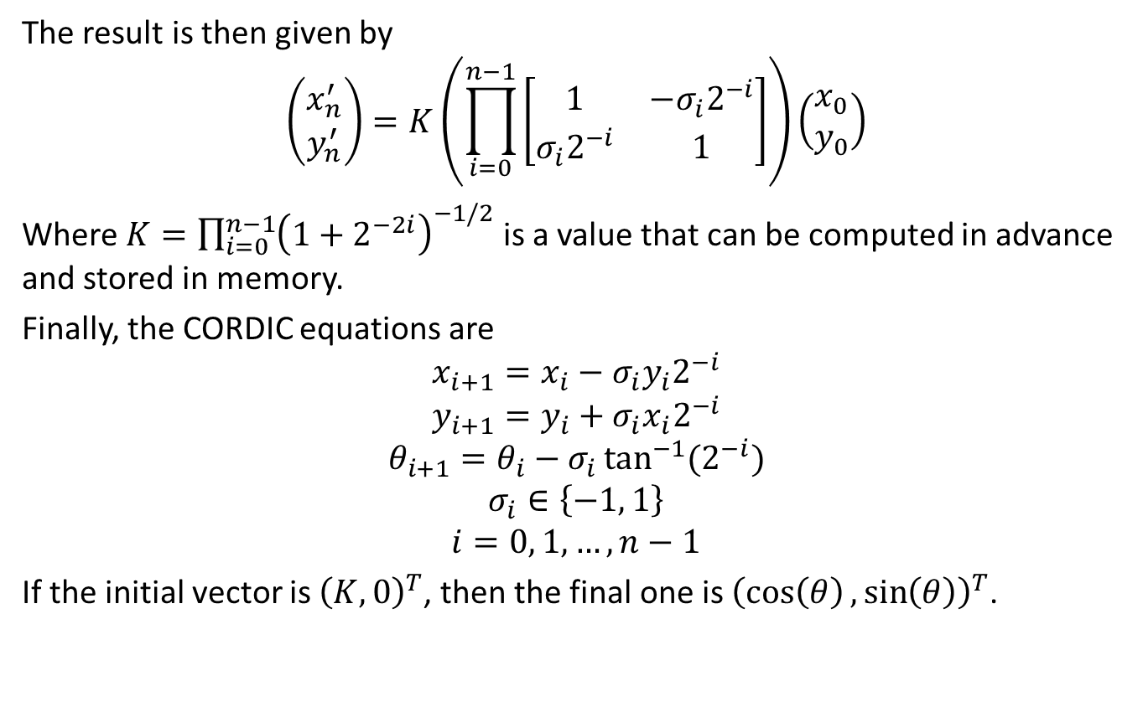
Basic CORDIC
The result is then given by
$$\left(\begin{matrix}x_{n}^{′} \\ y_{n}^{′}\end{matrix}\right)=K\left(\prod_{i=0}^{n−1}{\left[\begin{matrix}1 & {−σ}_{i}2^{−i} \\ σ_{i}2^{−i} & 1\end{matrix}\right]}\right)\left(\begin{matrix}x_{0} \\ y_{0}\end{matrix}\right)$$
Where $K=\prod_{i=0}^{n−1}{{\left(1+2^{−2i}\right)}^{−1/2}}$ is a value that can be computed in advance and stored in memory.
Finally, the CORDIC equations are
$$x_{i+1}=x_{i}−σ_{i}y_{i}2^{−i}$$
$$y_{i+1}=y_{i}+σ_{i}x_{i}2^{−i}$$
$$θ_{i+1}=θ_{i}−σ_{i}\tan^{−1}{(2^{−i})}$$
$$σ_{i}∈\left\{−1, 1\right\}$$
$$i=0, 1, …, n−1$$
If the initial vector is ${\left(K, 0\right)}^{T}$, then the final one is ${\left(\cos\left(θ\right),\sin\left(θ\right)\right)}^{T}$.

Slide 8
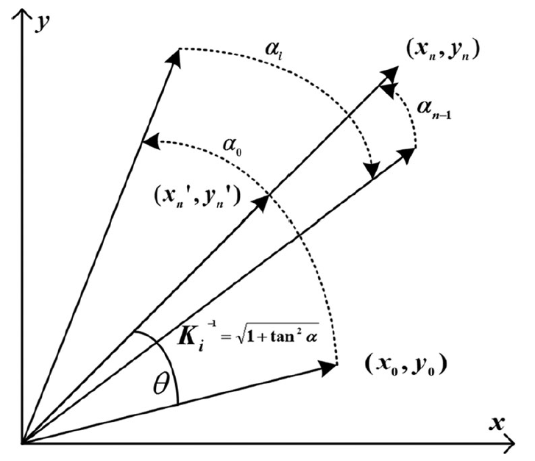
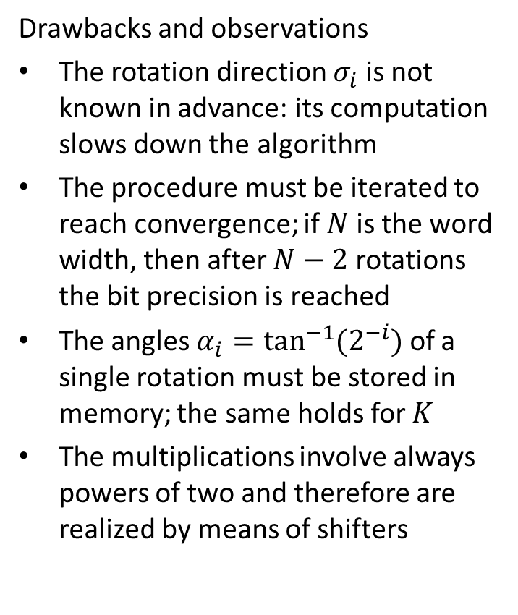
Basic CORDIC
Drawbacks and observations
The rotation direction $σ_{i}$ is not known in advance: its computation slows down the algorithm
The procedure must be iterated to reach convergence; if $N$ is the word width, then after $N−2$ rotations the bit precision is reached
The angles $α_{i}=\tan^{−1}{(2^{−i})}$ of a single rotation must be stored in memory; the same holds for $K$
The multiplications involve always powers of two and therefore are realized by means of shifters

Slide 9
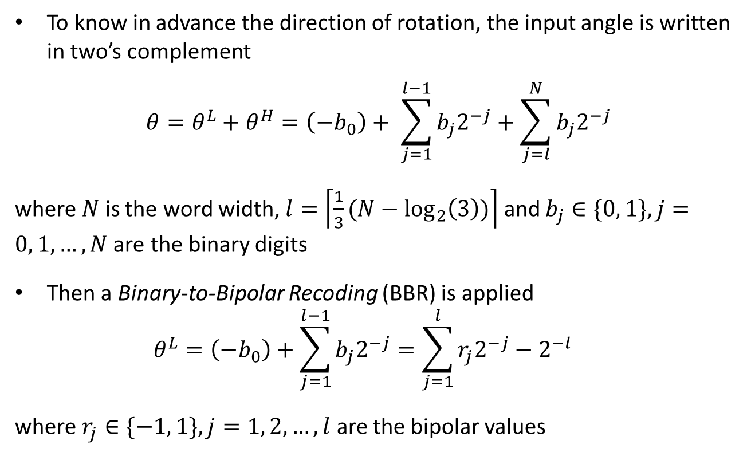
Parallel CORDIC (Para-CORDIC)
To know in advance the direction of rotation, the input angle is written in two’s complement
$$θ=θ^{L}+θ^{H}=\left(−b_{0}\right)+ \sum_{j=1}^{l−1}{b_{j}2^{−j}}+\sum_{j=l}^{N}{b_{j}2^{−j}}$$
where $N$ is the word width, $l=\left\lceil \frac{1}{3}(N−\log_{2}\left(3\right))\right\rceil$ and $b_{j}∈\{0, 1\}, j=0, 1, …, N$ are the binary digits
Then a Binary-to-Bipolar Recoding (BBR) is applied $θ^{L}=\left(−b_{0}\right)+\sum_{j=1}^{l−1}{b_{j}2^{−j}}=\sum_{j=1}^{l}{r_{j}2^{−j}}−2^{−l}$
where $r_{j}∈\{−1, 1\}, j=1, 2, …, l$ are the bipolar values

Slide 10
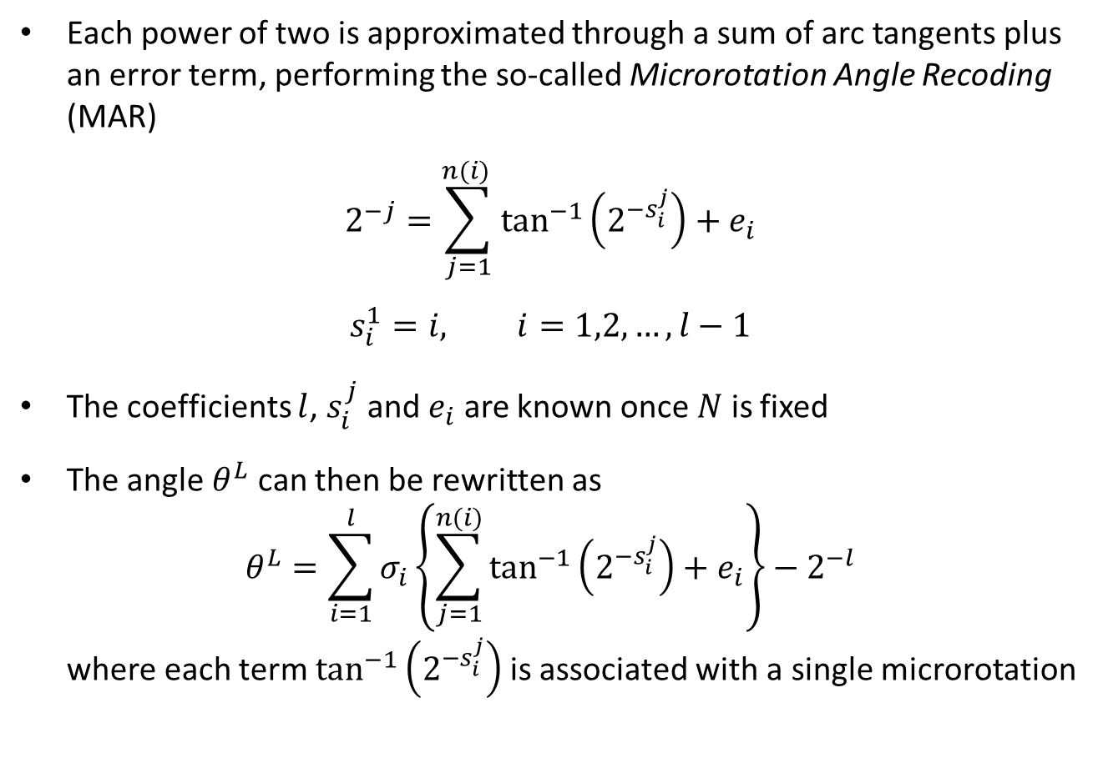
Para-CORDIC
Each power of two is approximated through a sum of arc tangents plus an error term, performing the so-called Microrotation Angle Recoding (MAR)
$$2^{−j}=\sum_{j=1}^{n(i) }{\tan^{−1}\left(2^{−s_{i}^{j}}\right)+e_{i}}$$
$$s_{i}^{1}=i, i=1,2,…,l−1$$
The coefficients $l$, $s_{i}^{j}$ and $e_{i}$ are known once $N$ is fixed
The angle $θ^{L}$ can then be rewritten as $θ^{L}=\sum_{i=1}^{l}{σ_{i}\left\{\sum_{j=1}^{n(i)}{\tan^{−1}\left(2^{−s_{i}^{j}}\right)+e_{i}}\right\}}−2^{−l}$ where each term $\tan^{−1}\left(2^{−s_{i}^{j}}\right)$ is associated with a single microrotation

Slide 11
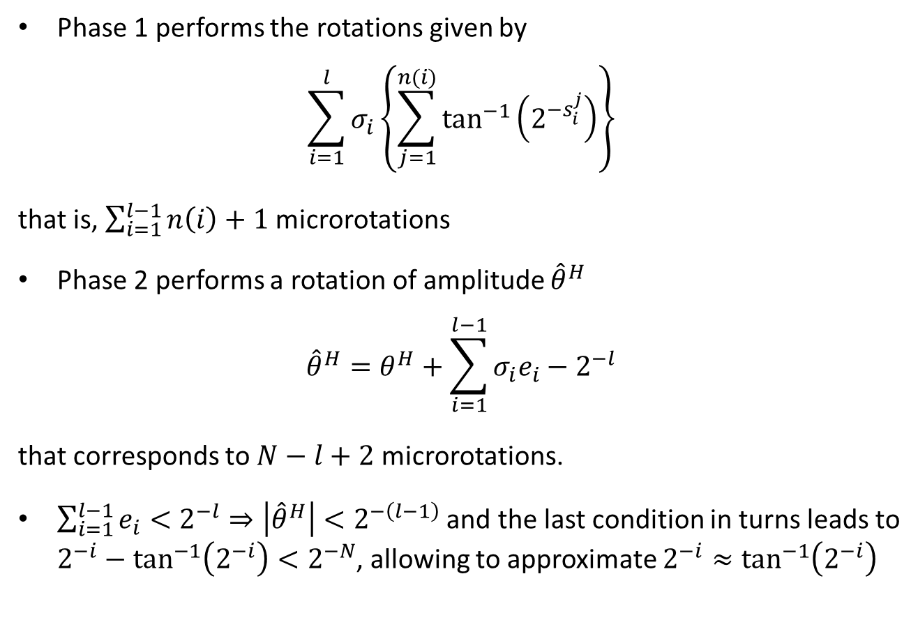
Para-CORDIC
Phase 1 performs the rotations given by
$$\sum_{i=1}^{l}{σ_{i}\left\{\sum_{j=1}^{n(i)}{\tan^{−1}\left(2^{−s_{i}^{j}}\right)}\right\}}$$
that is, $\sum_{i=1}^{l−1}{n\left(i\right)+1}$ microrotations
Phase 2 performs a rotation of amplitude ${\hat{θ}}^{H}$
$${\hat{θ}}^{H}=θ^{H}+\sum_{i=1}^{l−1}{σ_{i}e_{i}−2^{−l}}$$
that corresponds to $N−l+2$ microrotations.
$\sum_{i=1}^{l−1}{e_{i}}<2^{−l}⇒\left|{\hat{θ}}^{H}\right|<2^{−\left(l−1\right)}$ and the last condition in turns leads to $2^{−i}−\tan^{−1}\left(2^{−i}\right)<2^{−N}$, allowing to approximate $2^{−i}≈\tan^{−1}\left(2^{−i}\right)$

Slide 12
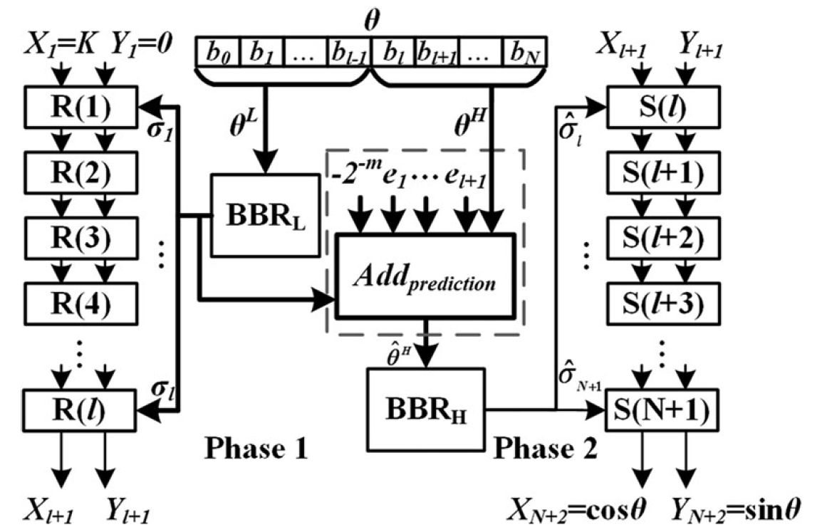
Para-CORDIC

Slide 13
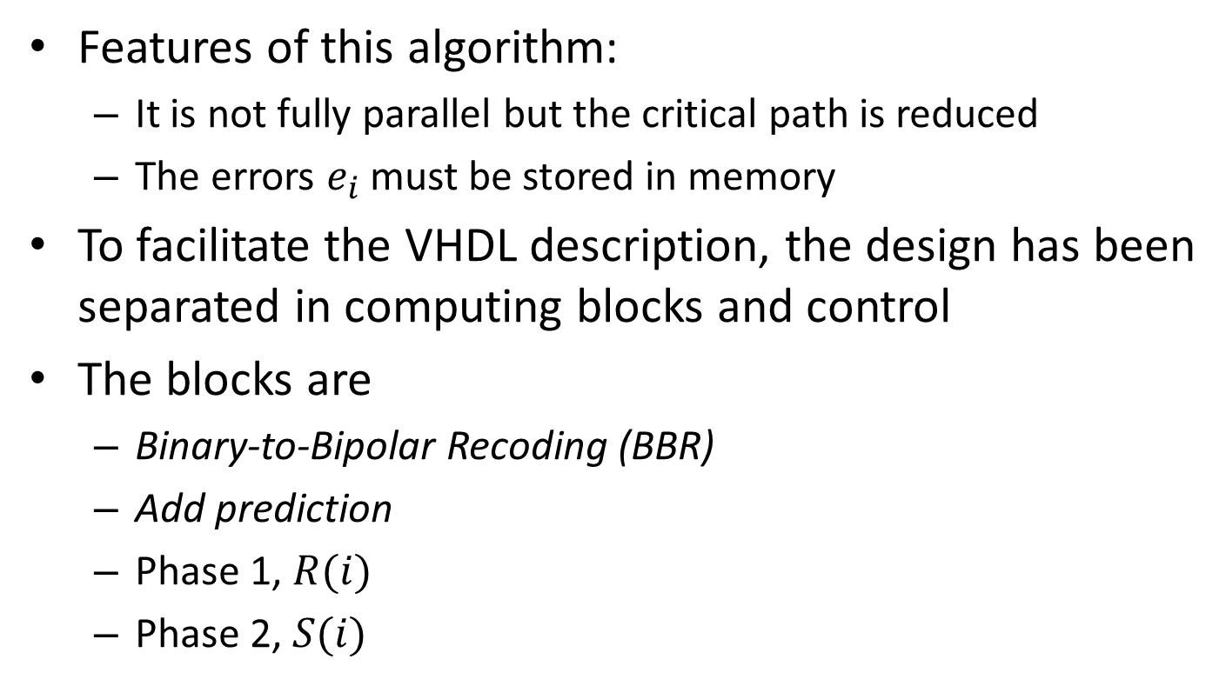
Para-CORDIC
Features of this algorithm:
It is not fully parallel but the critical path is reduced
The errors $e_{i}$ must be stored in memory
To facilitate the VHDL description, the design has been separated in computing blocks and control
The blocks are
Binary-to-Bipolar Recoding (BBR)
Add prediction
Phase 1, $R(i)$
Phase 2, $S(i)$

Slide 14
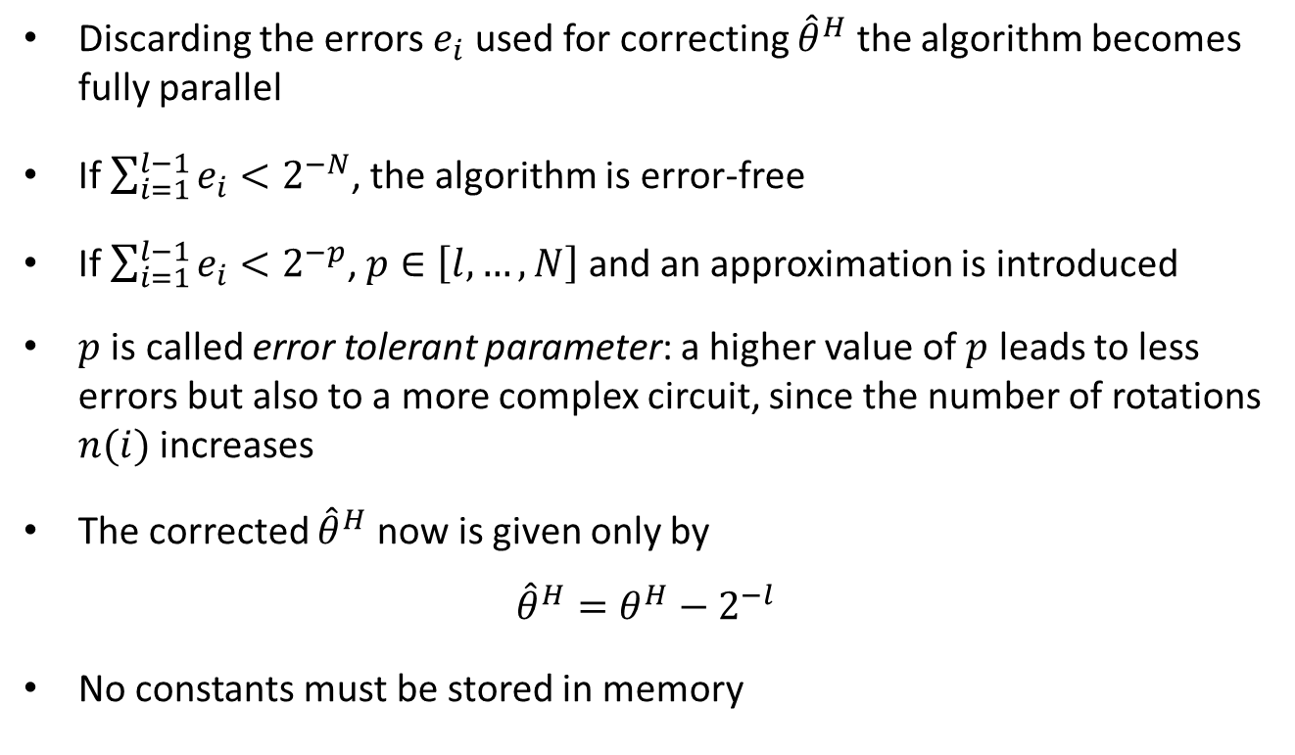
Fully Parallel Approximate CORDIC (FPAX-CORDIC)
Discarding the errors $e_{i}$ used for correcting ${\hat{θ}}^{H}$ the algorithm becomes fully parallel
If $\sum_{i=1}^{l−1}{e_{i}}<2^{−N}$, the algorithm is error-free
If $\sum_{i=1}^{l−1}{e_{i}}<2^{−p}$, $p∈\left[l, …, N\right]$ and an approximation is introduced
$p$ is called error tolerant parameter: a higher value of $p$ leads to less errors but also to a more complex circuit, since the number of rotations $n(i)$ increases
The corrected ${\hat{θ}}^{H}$ now is given only by
$${\hat{θ}}^{H}=θ^{H}−2^{−l}$$
No constants must be stored in memory

Slide 15
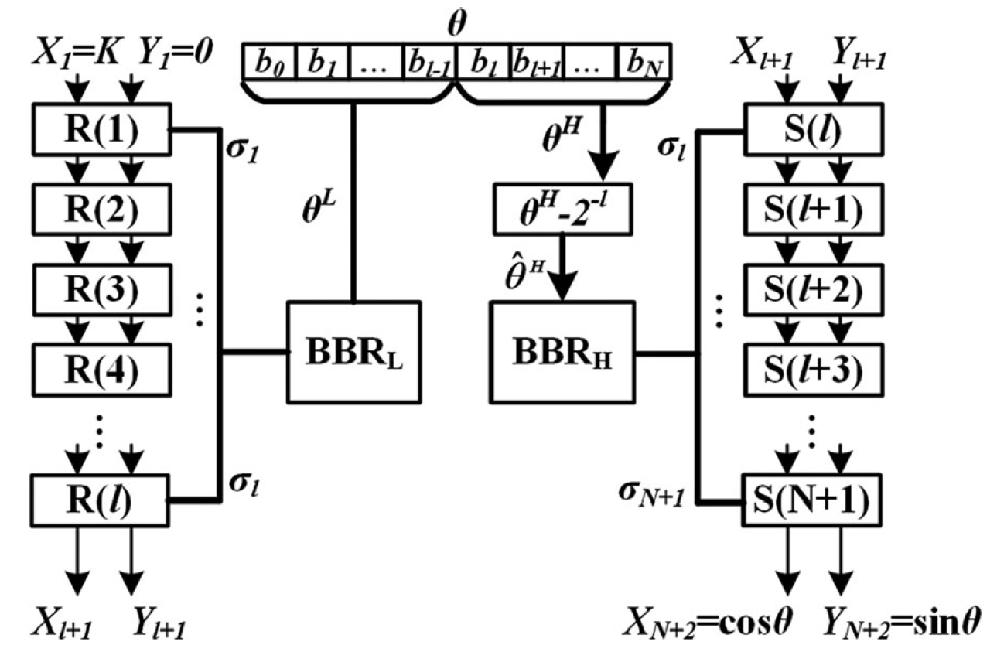
FPAX-CORDIC

Slide 16
Table of contents
Introduction
Algorithms
Original CORDIC
Para-CORDIC
FPAX-CORDIC
Hardware implementations
Comparisons
Demo
Conclusion

Slide 17
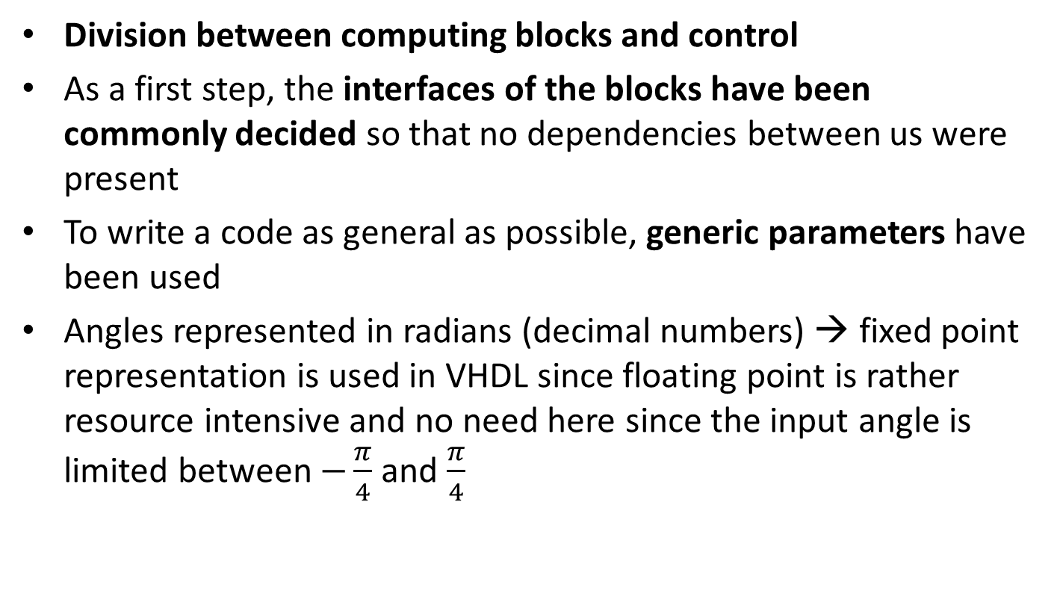
Hardware implementations
Division between computing blocks and control
As a first step, the interfaces of the blocks have been commonly decided so that no dependencies between us were present
To write a code as general as possible, generic parameters have been used
Angles represented in radians (decimal numbers) → fixed point representation is used in VHDL since floating point is rather resource intensive and no need here since the input angle is limited between $−\frac{π}{4}$ and $\frac{π}{4}$
Notes:
By implementing combinatorial computation steps as a sequence of combinatorial blocks instead of using clocked loops, a faster computation speed can be achieved
Due to physical delay present in hardware increasing the number of elements in a sequence does increase the computation time
Therefore increasing parallelism will not decrease computation time in the same order
A trade-off between area and time has to be chosen and based on this the design has to be generated

Slide 18
Table of contents
Introduction
Algorithms
Original CORDIC
Para-CORDIC
FPAX-CORDIC
Hardware implementations
Comparisons
Demo
Conclusion

Slide 19
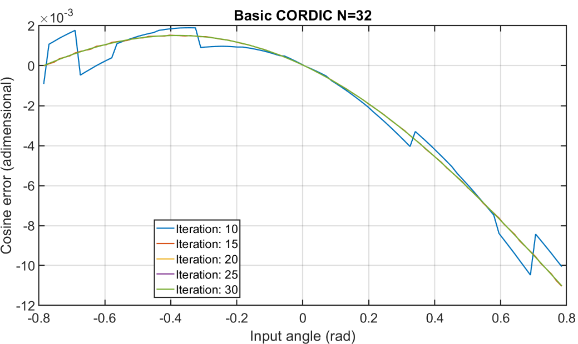
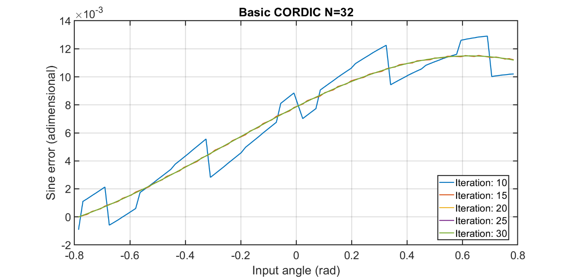
Accuracy – Basic cordic

Slide 20
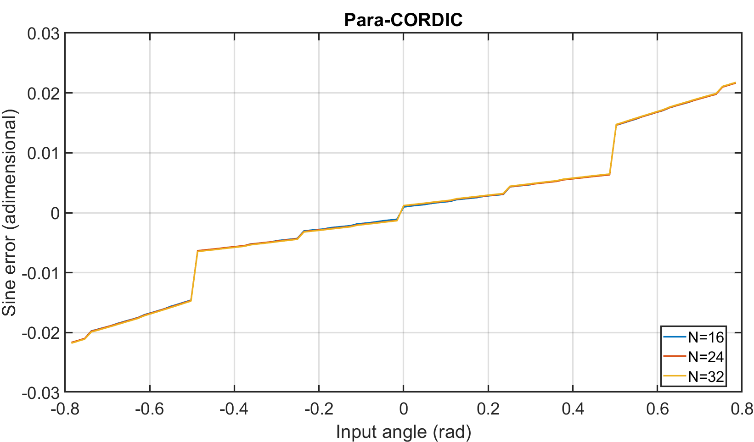
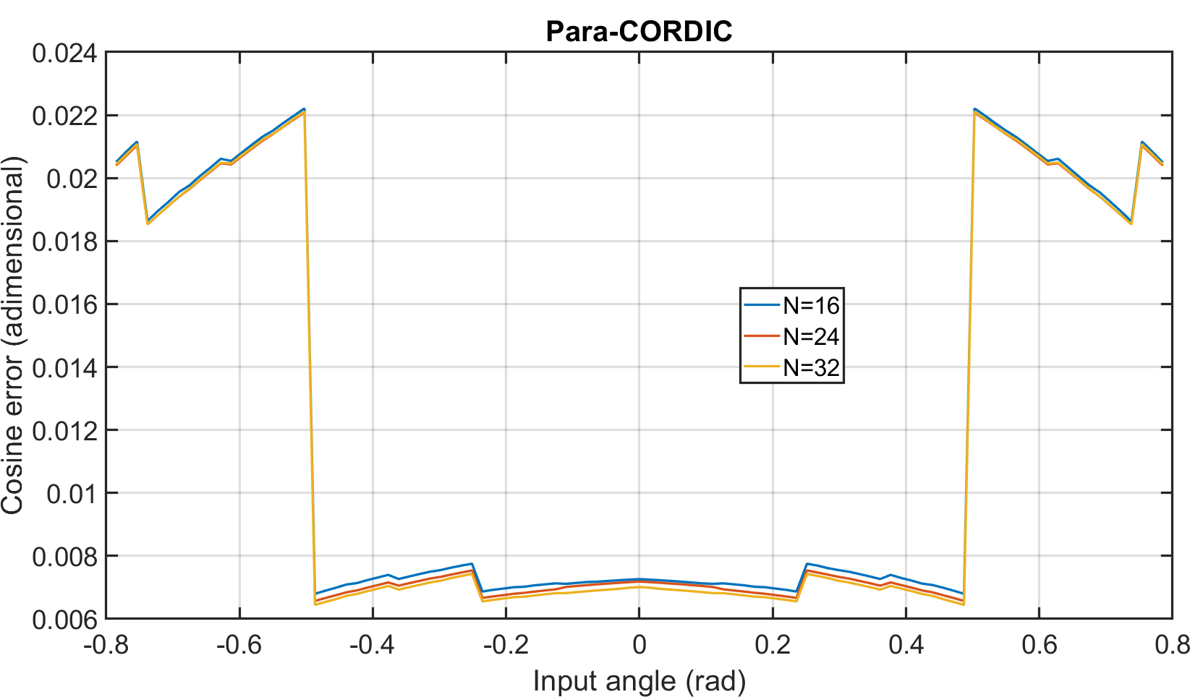
Accuracy – Para cordic

Slide 21
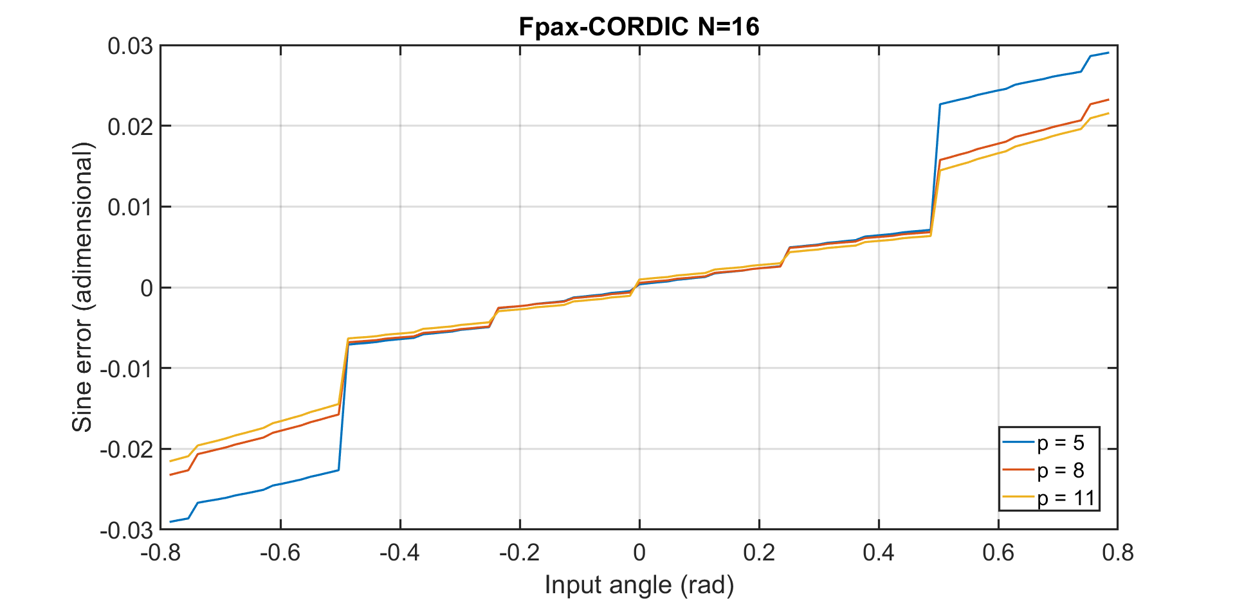
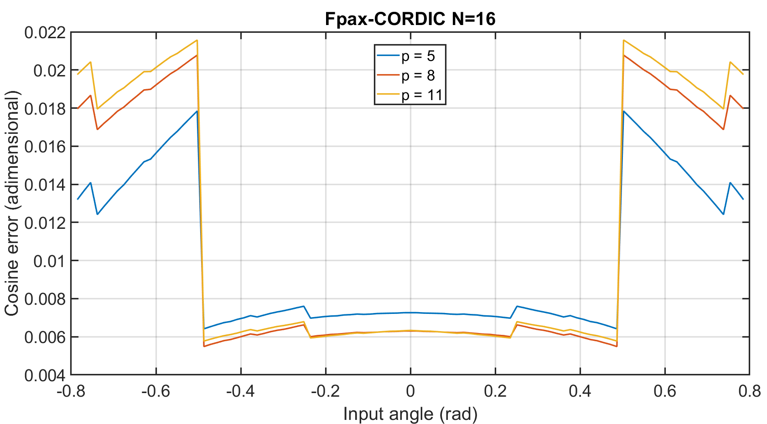
Accuracy – FPAX
Error due to approximation

Slide 22
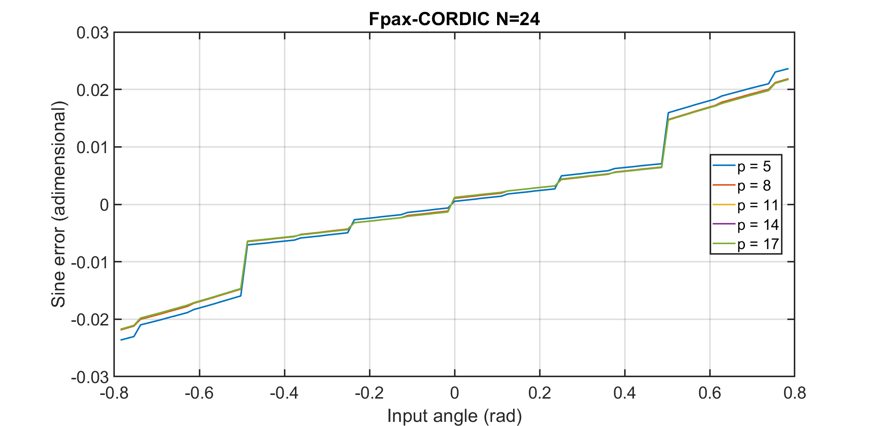
Accuracy – FPAX: Influence of the bitlength
Decreasing effect of the error term with increasing bit length

Slide 23

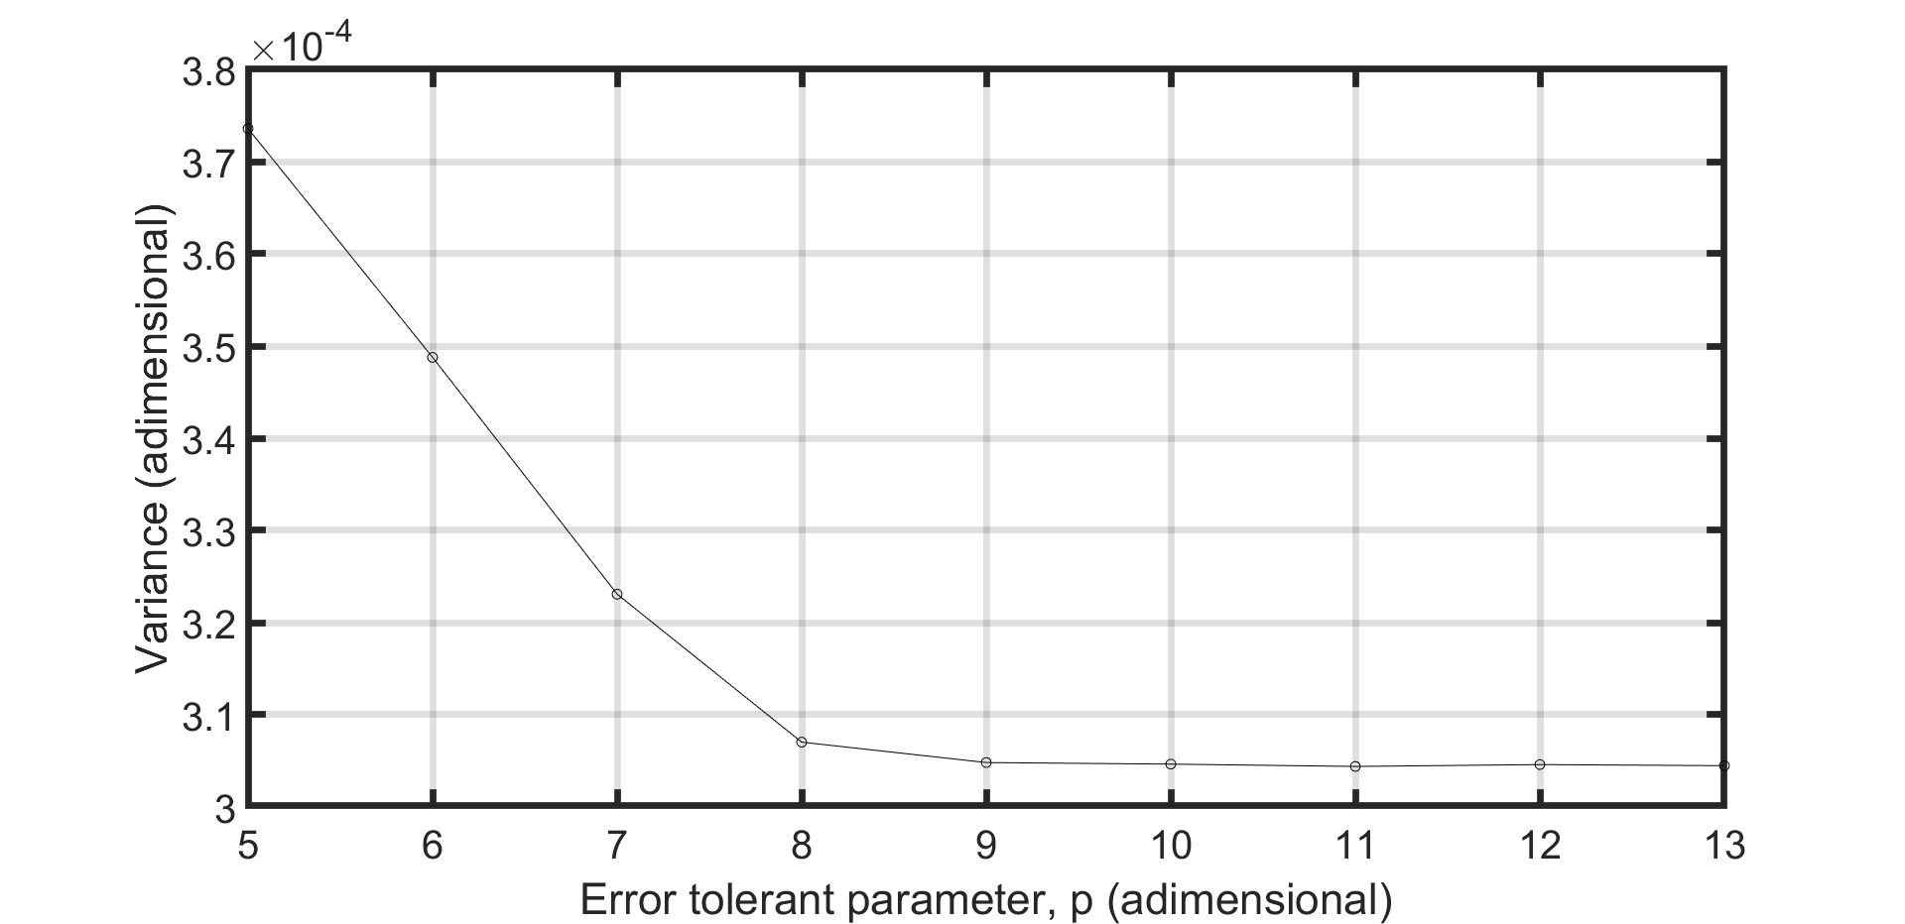
Accuracy – FPAX: Influence of the error tolerant parameter p

Slide 24
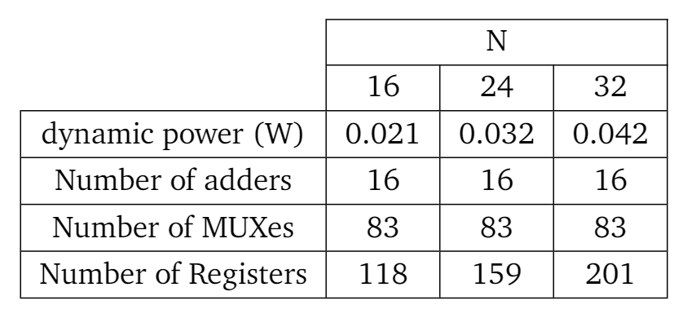
Power, Delay, Area – Basic CORDIC

Slide 25
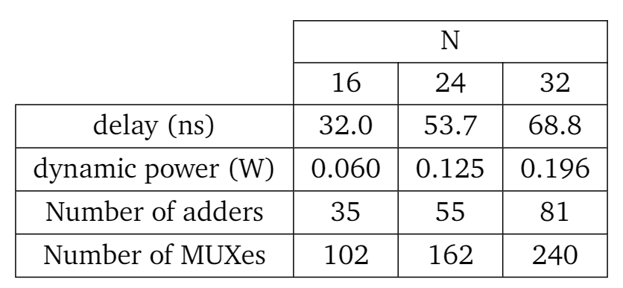
Power, Delay, Area – Para-CORDIC

Slide 26
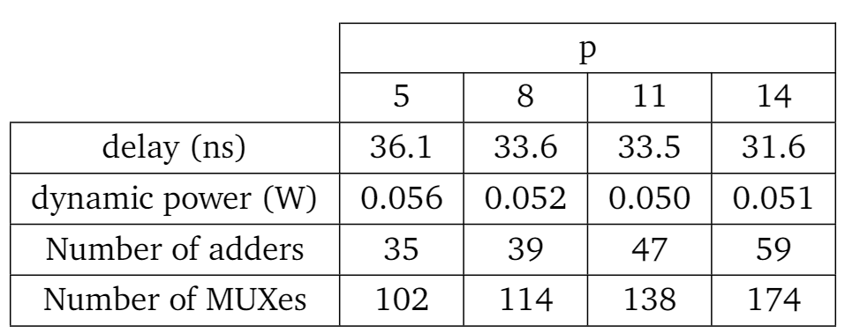
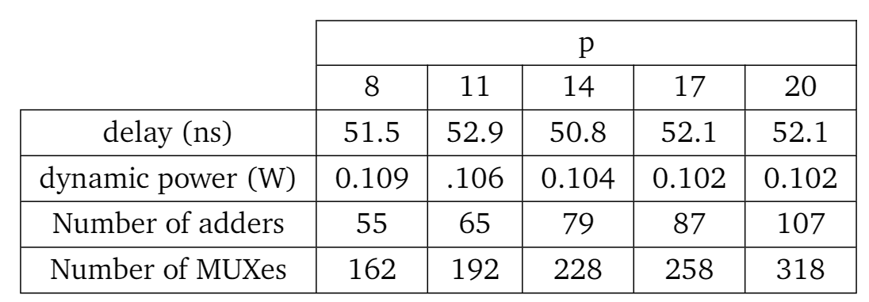
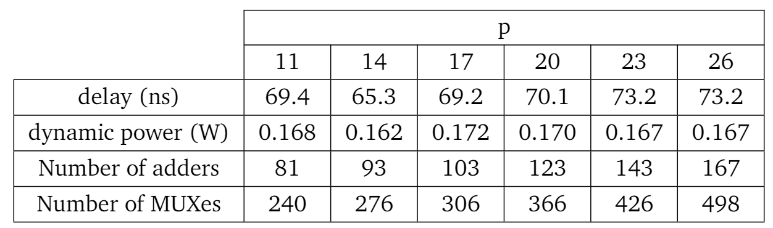
Power, Delay, Area – Fpax-CORDIC
N=16 bit
N=24 bit
N=32 bit

Slide 27
Table of contents
Introduction
Algorithms
Original CORDIC
Para-CORDIC
FPAX-CORDIC
Hardware implementations
Comparisons
Demo
Conclusion

Slide 28
Table of contents
Introduction
Algorithms
Original CORDIC
Para-CORDIC
FPAX-CORDIC
Hardware implementations
Comparisons
Demo
Conclusion

Slide 29
Conclusion
The three proposed algorithms have been studied, described in VHDL and implemented on the FPGA
The key idea of approximate computing has been verified through accuracy and area comparisons
The results obtained for power and delay must be taken carefully
The material that has been produced is available at the following link: https://github.com/Gianne97/Enhancing\_performances

Slide 30
References
Sekanina, Lukas. "Introduction to approximate computing: Embedded tutorial." 2016 IEEE 19th International Symposium on Design and Diagnostics of Electronic Circuits & Systems (DDECS). IEEE, 2016.
Volder, Jack. "The CORDIC computing technique." Papers presented at the the March 3-5, 1959, western joint computer conference. 1959.
Andraka, Ray. "A survey of CORDIC algorithms for FPGA based computers." Proceedings of the 1998 ACM/SIGDA sixth international symposium on Field programmable gate arrays. 1998.
Juang, Tso-Bing, Shen-Fu Hsiao, and Ming-Yu Tsai. "Para-CORDIC: parallel CORDIC rotation algorithm." IEEE Transactions on Circuits and Systems I: Regular Papers 51.8 (2004): 1515-1524.
Wang, Shaoyun, Vincenzo Piuri, and E. E. Wartzlander. "Hybrid CORDIC algorithms." IEEE Transactions on Computers 46.11 (1997): 1202-1207.
Chen, Linbin, et al. "Algorithm and design of a fully parallel approximate coordinate rotation digital computer (CORDIC)." IEEE Transactions on Multi-Scale Computing Systems 3.3 (2017): 139-151.

Slide 31
Thanks for your attention
Giacomo Giannetti 12006424 e12006424@student.tuwien.ac.at
Benjamin Gräf 51832224
Zifei Li 51813032
Amer Ahmic 1225650

Slide 32
Backstage slides

